Slide 1
Governance
The forgotten key to managing Cloud

Slide 2









Thank you to our sponsors!
Gold Sponsors
Silver Sponsors
Community Sponsors

Slide 4
Governance
The forgotten cloud killer

Slide 5
We’re doing this in the cloud because our IT don’t have time to be involved

Slide 6
We’ll build the prototype and then worry about governance

Slide 7
Cloud is new to us, so we’re looking for this development team to work it out as they go

Slide 8
Unexpected high billing
Data outside accepted jurisdiction
No audit trail
No way to associate cost with department
Component services unavailable in acceptable regions
Unsecured personal data

Slide 9
Areas of Governance

Slide 10
Technology Governance
What Azure services are acceptable for use in projects… …because of where they store your data …because of how they deal with your data …because of how skilled you are in using them …because of what your existing choice is in that area

Slide 11
Location Governance
What Azure regions are acceptable for use… …because of where you need to store your data …because of how much they cost …because of where your customers are …because of where your customers need to store their data

Slide 12
Security Governance
How access to cloud services is controlled… …because you need to limit access to data …because you need to audit activity …because your customer mandates specific processes …because people join and leave your organisation

Slide 13
Purchasing Governance
How you report on and recharge Cloud costs, and purchase the services… …because you want to be cost-effective …because you need to internally recharge …because you need to bill your customers

Slide 14
Implementation
Resource naming convention
Grouping resources by Resource Group
Grouping resources by Subscription
Resource tags
Identity management
RBAC
Reporting

Slide 15
Governance Automation

Slide 16

The IT/Business Dilemma
Speed versus control
Development
IT Governance
Speed
Control
Self-service
Production access
Rapid releases
Policies
Security
Cost Mgmt

Slide 17
Speed and Control
Developers
Cloud Custodian Team
Built-in controls through policy instead of workflow
Operations

Slide 18



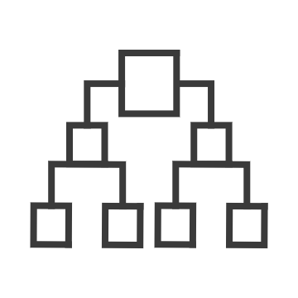
Native platform capabilities to ensure compliant use of cloud resources
Policy
Blueprints
Resource Graph
Management Group
Cost
Real-time enforcement, compliance assessment and remediation
Deploy and update cloud environments in a repeatable manner using composable artifacts
Query, explore & analyze cloud resources at scale
Define organizational hierarchy
Monitor cloud spend and optimize resources
Control
Environment
Visibility
Hierarchy
Consumption

Slide 19


Speed and Control
Management Groups
Blueprints
Cost Management
Templates
Development
Cloud Custodian
Speed
RBAC
Control
Resource
Graph
Policies
Mgmt as code
Agile Development
Policies
Security
Cost Control
Policies

Slide 20
Key Azure governance technologies
"policyRule": {
"if": {
"not": {
"field": "location",
"in": "[parameters('listOfAllowedLocations')]"
}
},
"then": {
"effect": "Deny"
}
}
Resources
RBAC
Policies
Policy
Blueprints
Management groups
Enforce or audit rules to ensure compliance.
Quickly create multiple subscriptions with resources, policies and users already setup.
Map your organizational structure into Azure to enable governance in multi-tenant and cross-regional scenarios
Azure Resource Manager + Azure Resource Graph
Notes:
Azure Policy Samples: https://docs.microsoft.com/en-gb/azure/governance/policy/samples/index
Azure Policy: https://docs.microsoft.com/en-gb/azure/governance/policy/
Azure Blueprints: https://docs.microsoft.com/en-us/azure/governance/blueprints/
Azure Management Groups: https://docs.microsoft.com/en-us/azure/governance/management-groups/

Slide 21
Azure Governance Architecture
providing control over the cloud environment, without sacrificing developer agility
Policy Definitions
Role-based Access
ARM Templates
Management Groups
Azure Portal
CLI
3rd party
Environment Factory: Deploy and update cloud environments in a repeatable manner using composable artifacts
Subscriptions
CRUD
Query
Azure Blueprints
Policy Engine
Azure Resource Graph
Azure Resource Manager (ARM)
2. Policy-based Control: Real-time enforcement, compliance assessment and remediation at scale
3. Resource Visibility: Query, explore & analyze cloud resources at scale
Virtual Machine
Storage
Network
…
Resource Provider

Slide 22

Azure Policy
Turn on built-in policies or build custom ones for all resource types
Apply policies to a Management Group with control across your entire organization
Real time remediation
Real-time policy evaluation and enforcement
Apply multiple policies and & aggregate policy states with policy initiative
Remediation on existing resources (NEW)
Periodic & on-demand compliance evaluation
Exclusion Scope
VM In-Guest Policy (NEW)
Enforcement & Compliance
Apply policies at scale
Remediation

Slide 23



Azure Blueprints
Role-based access controls
deploy and update cloud environments in a repeatable manner using composable artifacts
Policy Definitions
Subscription A
ARM Templates
Azure Blueprints
Subscription B
Subscription C
…
compose
manage
scale

Slide 24
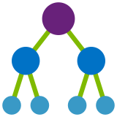
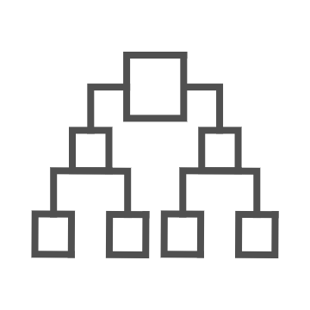
Azure Management Groups
Make environment management easier by grouping subscriptions together
Create a hierarchy of management groups that fit your organization
Apply governance controls with policies and access controls along with other Azure services
Grouping subscriptions into logical groups allow for new organization models
Inheritance allows for single assignment of controls that apply to all subscriptions
Aggregated views above the subscription level
Create a flexible hierarchy that can be updated quickly
Hierarchy doesn’t need to model the organizations billing hierarchy
Can easily scale up or down depending on the organizational needs
Azure Resource Manager (ARM) objects that allow integrations with other Azure services
Azure services:
Azure Policy
RBAC
Azure Cost Management
Azure Blueprints
Azure Security Center

Slide 25
Demo
Governance in the Azure Portal

Slide 26
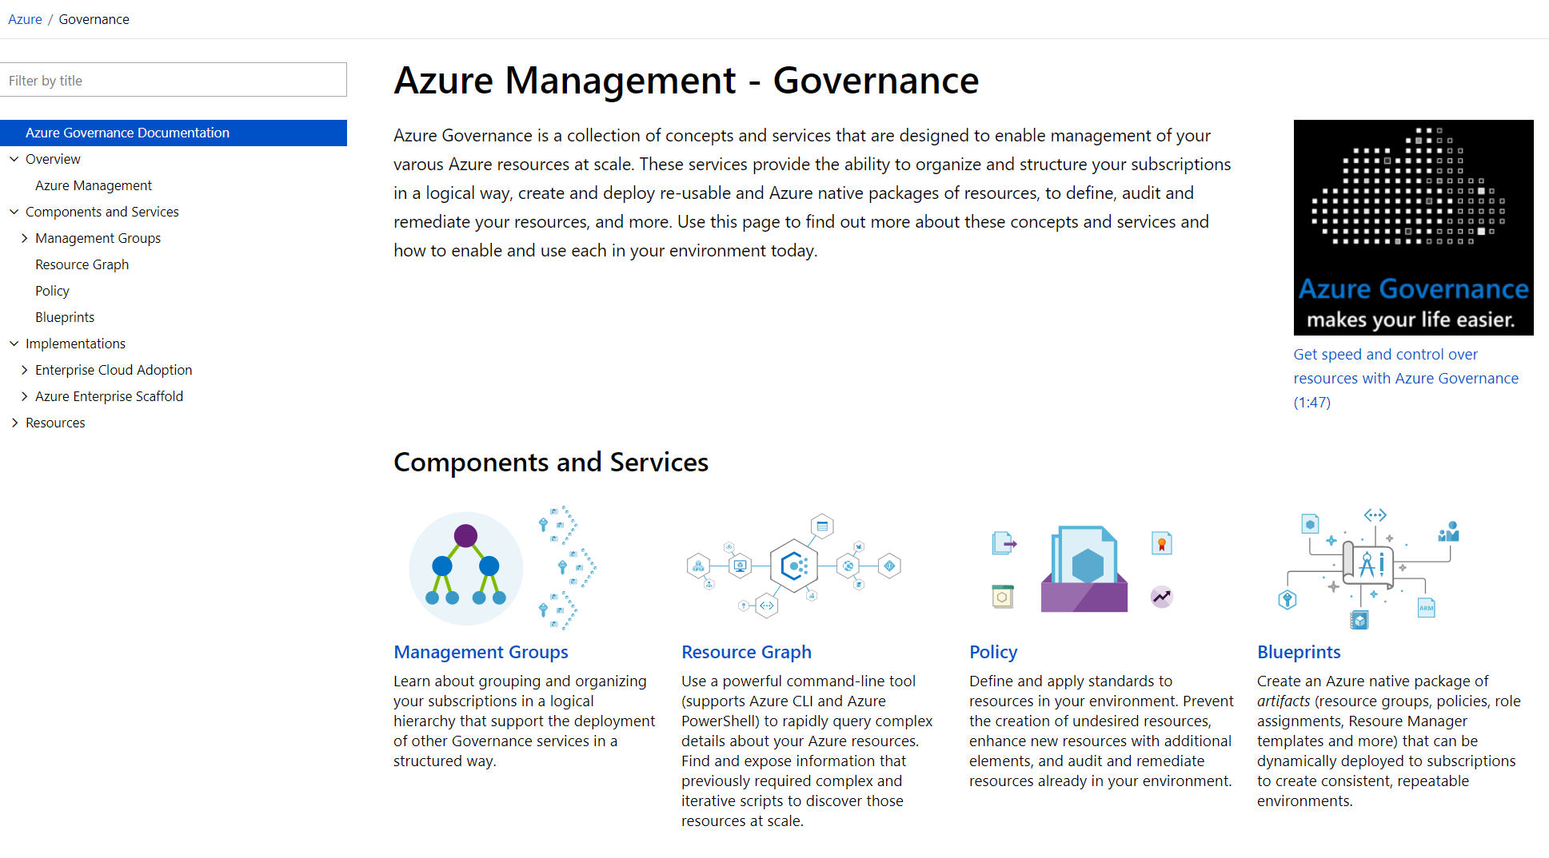
aka.ms/GovernanceDocs -or- docs.microsoft.com/azure/governance

Slide 27



Next on the agenda…
Track 1
11:55 – 12:40
Architecting Autonomous Driving Solutions on Azure
Kristof Rennen
Track 2
11:55 – 12:40
From One Release Per Quarter To 30 Times A Day
Marcel de Vries
@rikhepworth
Github.com/rikhepworth
blogs.blackmarble.co.uk

